Slide 1
Bioinformatics: A perspective
Dr. Matthew L. Settles
Genome Center
University of California, Davis
settles@ucdavis.edu

Slide 2
Outline
The World we are presented with
Bioinformatics as Data Science
Training
The Bottom Line
GC Cores and updates

Slide 3
Sequencing Costs
July 2017
$0.012/Mb
$1,121 per Human sized (30x) genome
Includes: labor, administration, management, utilities, reagents, consumables, instruments (amortized over 3 years), informatics related to sequence productions, submission, indirect costs.
http://www.genome.gov/sequencingcosts/

Slide 4
Growth in Public Sequence Database
WGS > 1 trillion bp
http://www.ncbi.nlm.nih.gov/genbank/statistics
http://www.ncbi.nlm.nih.gov/Traces/sra/

Slide 5
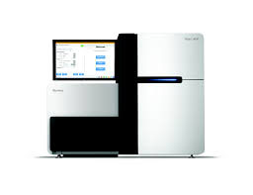
Illumina
2006 – The second ‘Next Generation Sequencing’ platform was Solexa (later acquired by Illumina). Now the dominant platform with >75% market share of sequencers and and estimated >90% of all bases sequenced are from an Illumina machine, Sequencing by Synthesis > 1,600Gb/day.
New NovaSeq

Slide 6
Flexibility – short but not too short
Single Multiplexing
Genomic reduction allows for greater coverage and multiplexing of samples.
You can fine tune your depth of coverage needs and sample size
with the reduction technique
1X
Whole Genome
Exome
RNA
GBS
Capture Techniques
RADseq
Depth of Coverage
Fluidigm Access Array
Amplicons
Few or Single Amplicons
1KB
100000X
Read 2 primer
Greater Multiplexing
Read 2 (50-300bp)
DNA Sequence
Barcodes
Read 1 (50- 300bp)
Barcode (8bp)
Barcode Read primer

Slide 7
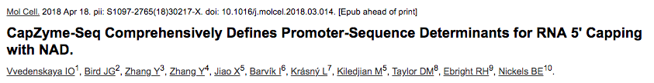
Sequencing Libraries : MLA-seq
DNA-seq
RNA-seq
Amplicons
CHiP-seq
MeDiP-seq
RAD-seq
ddRAD-seq
DNase-seq
ATAC-seq
MNase-seq
FAIRE-seq
Ribose-seq
smRNA-seq
tagRNA-seq
PAT-seq
Structure-seq
MPE-seq
STARR-seq
Mod-seq
EnD-seq
Pool-seq
G&T-seq
Tn-Seq
BrAD-seq
SLAF-seq

Slide 8
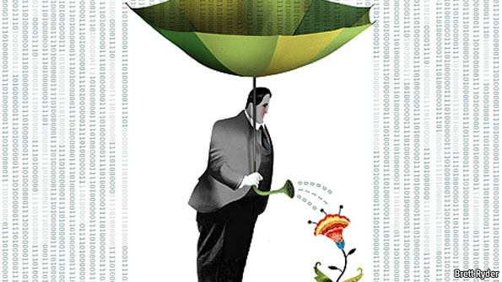
The data deluge
Plucking the biology from the Noise

Slide 9
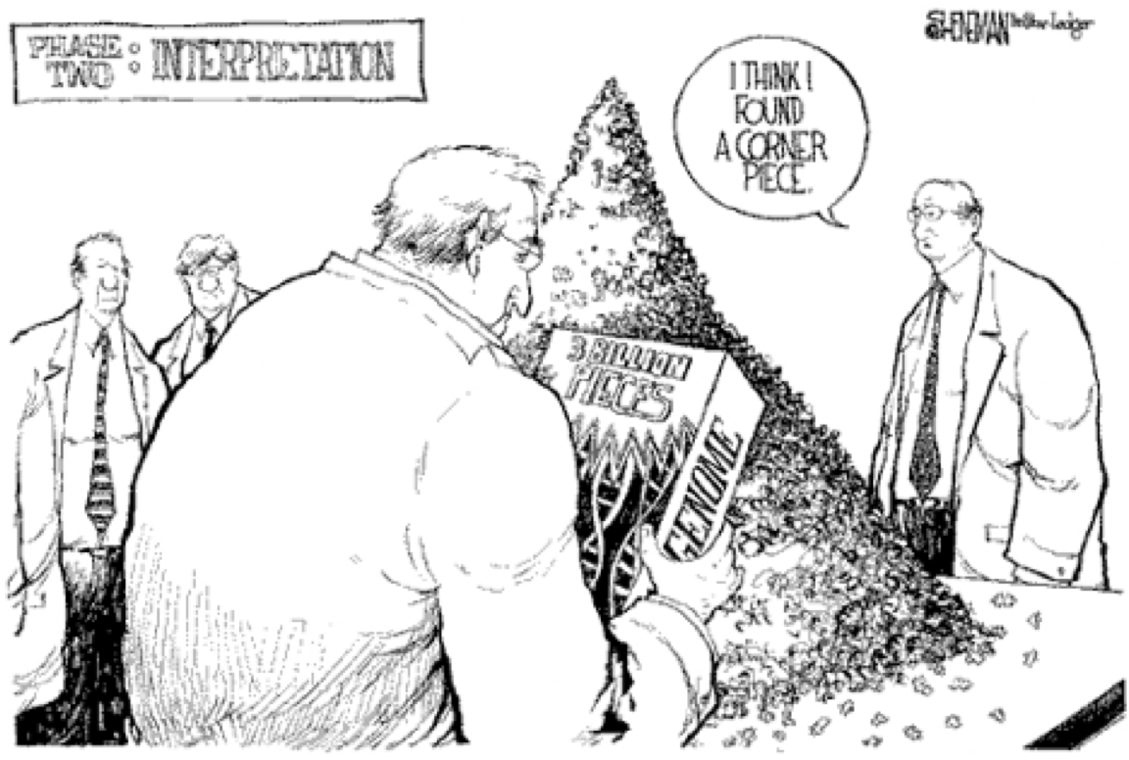
Reality
Its much more difficult than we may first think

Slide 10
Bioinformatics is a Data Science
Data science is the process of formulating a quantitative question that can be answered with data, collecting and cleaning the data, analyzing the data, and communicating the answer to the question to a relevant audience.
Five Fundamental Concepts of Data Science
statisticsviews.com November 11, 2013 by Kirk Borne
Notes:
Kirk Borne – George Mason University

Slide 11
7 Stages to Data Science
Define the question of interest
Get the data
Clean the data
Explore the data
Fit statistical models
Communicate the results
Make your analysis reproducible

Slide 12
Define the question of interest
Begin with the end in mind!
what is the question
how are we to know we are successful
what are our expectations
dictates
the data that should be collected
the features being analyzed
which algorithms should be use

Slide 13
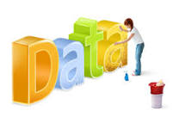
Get the data
Clean the data
Explore the data
Know your data!
know what the source was
technical processing in producing data (bias, artifacts, etc.)
“Data Profiling”
Data are never perfect but love your data anyway!
the collection of massive data sets often leads to unusual , surprising, unexpected and even outrageous.

Slide 14
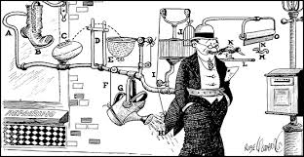
Fit statistical models
Over fitting is a sin against data science!
Model’s should not be over-complicated
If the data scientist has done their job correctly the statistical models don't need to be incredibly complicated to identify important relationships
In fact, if a complicated statistical model seems necessary, it often means that you don't have the right data to answer the question you really want to answer.

Slide 15
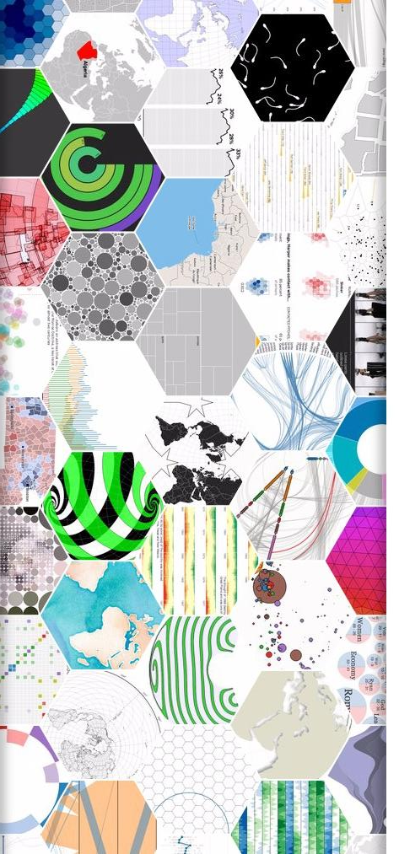
Communicate the results
Make your analysis reproducible
Remember that this is ‘science’!
We are experimenting with data selections, processing, algorithms, ensembles of algorithms, measurements, models. At some point these must all be tested for validity and applicability to the problem you are trying to solve.

Slide 16
Data science done well looks easy – and that’s a big problem for data scientists
simplystatistics.org
March 3, 2015 by Jeff Leek
Bad data science (bioinformatics) done also looks easy

Slide 17
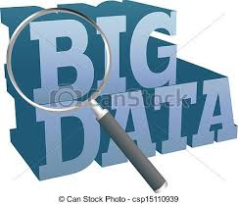

Bioinformatics Background
Computational Biology
Biology
Math
Statistics
Computer
Science
Biostatistics
Bioinformatics
‘The data scientist role has been described as “part analyst, part artist.”’
Anjul Bhambhri, vice president of big data products at IBM
Notes:
Big data is an evolving term that describes any voluminous amount of structured, semi-structured and unstructured data that has the potential to be mined for information.
The Cloud is just a rebranding of

Slide 18
Prerequisites for doing Bioinformatics
Access to a multi-core (24 cpu or greater), ‘high’ memory 64Gb or greater Linux server.
Familiarity with the ’command line’ and at least one programming language.
Basic knowledge of how to install software
Basic knowledge of R (or equivalent) and statistical programming
Basic knowledge of Statistics and model building

Slide 19
Training - Models
Workshops
Often enrolled too late
Collaborations
More experience persons
Apprenticeships
Previous lab personnel to young personnel
Formal Education
Most programs are graduate level
Few Undergraduate

Slide 20
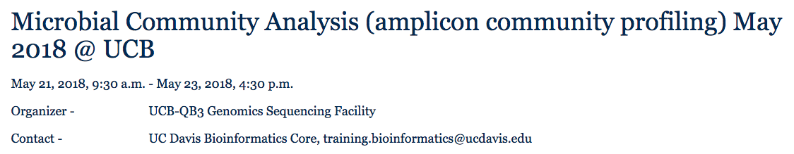
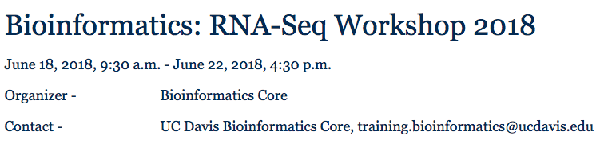
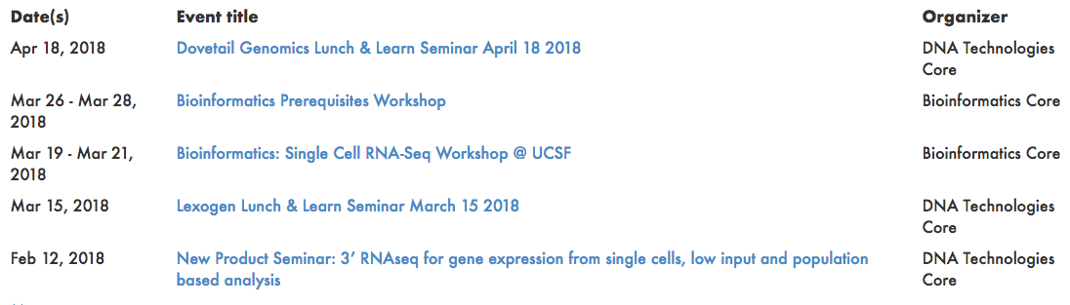
Training
http://registration.genomecenter.ucdavis.edu/

Slide 21
The Data Science in Bioinformatics
Bioinformatics is not something you are taught,
it’s a way of life
“The best bioinformaticians I know are problem solvers – they start the day not knowing something, and they enjoy finding out (themselves) how to do it. It’s a great skill to have, but for most, it’s not even a skill – it’s a passion, it’s a way of life, it’s a thrill. It’s what these people would do at the weekend (if their families let them).”
Mick Watson – Rosland Institute
Notes:
How-To: Workshops are by and large unaffected

Slide 22

The last mile
http://www.bikeblanket.com/blog/suisse

Slide 23
The real cost of sequencing
Sboner et al. Genome Biology 2011 12:125 doi:10.1186/gb-2011-12-8-125

Slide 24
One way to think about cores
Sample
Result

Slide 25
-omics is “Collaborative Research”
Todays experiments are complex and getting more complex.
No one person, or even one group typically has the needed capabilities in all areas.
Life
Science
Researchers
Data Generation
Cores
Bioinformatics

Slide 26
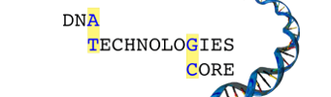

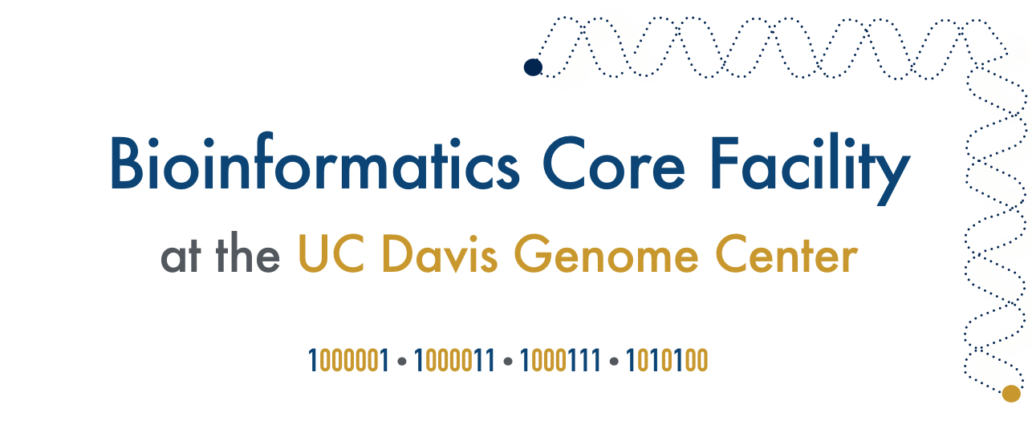
Core Coordination, Collaboration
PI Research Lab
Computational Research Lab

Slide 27
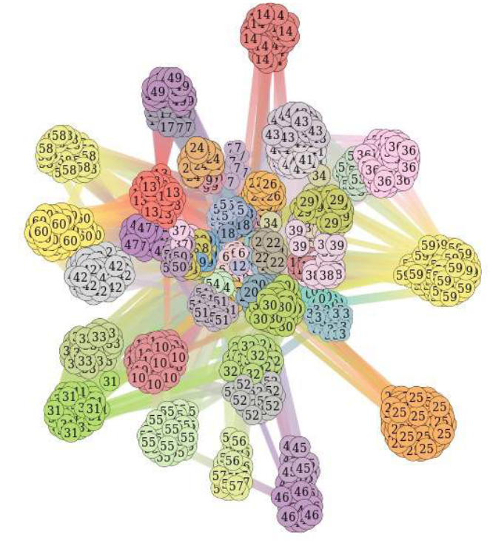
Technology
PacBio Sequel
Illumina Novaseq
Hi-C for Metagenomes

Slide 28
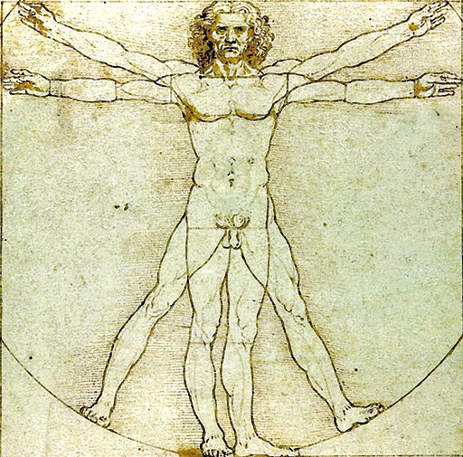
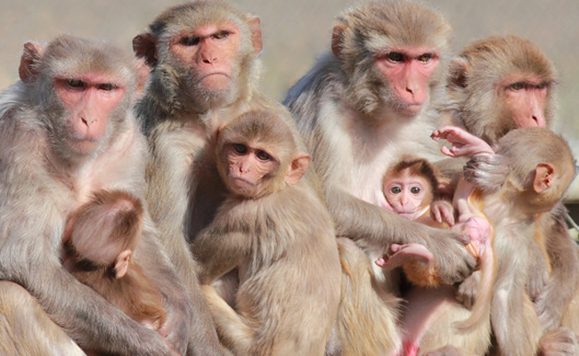

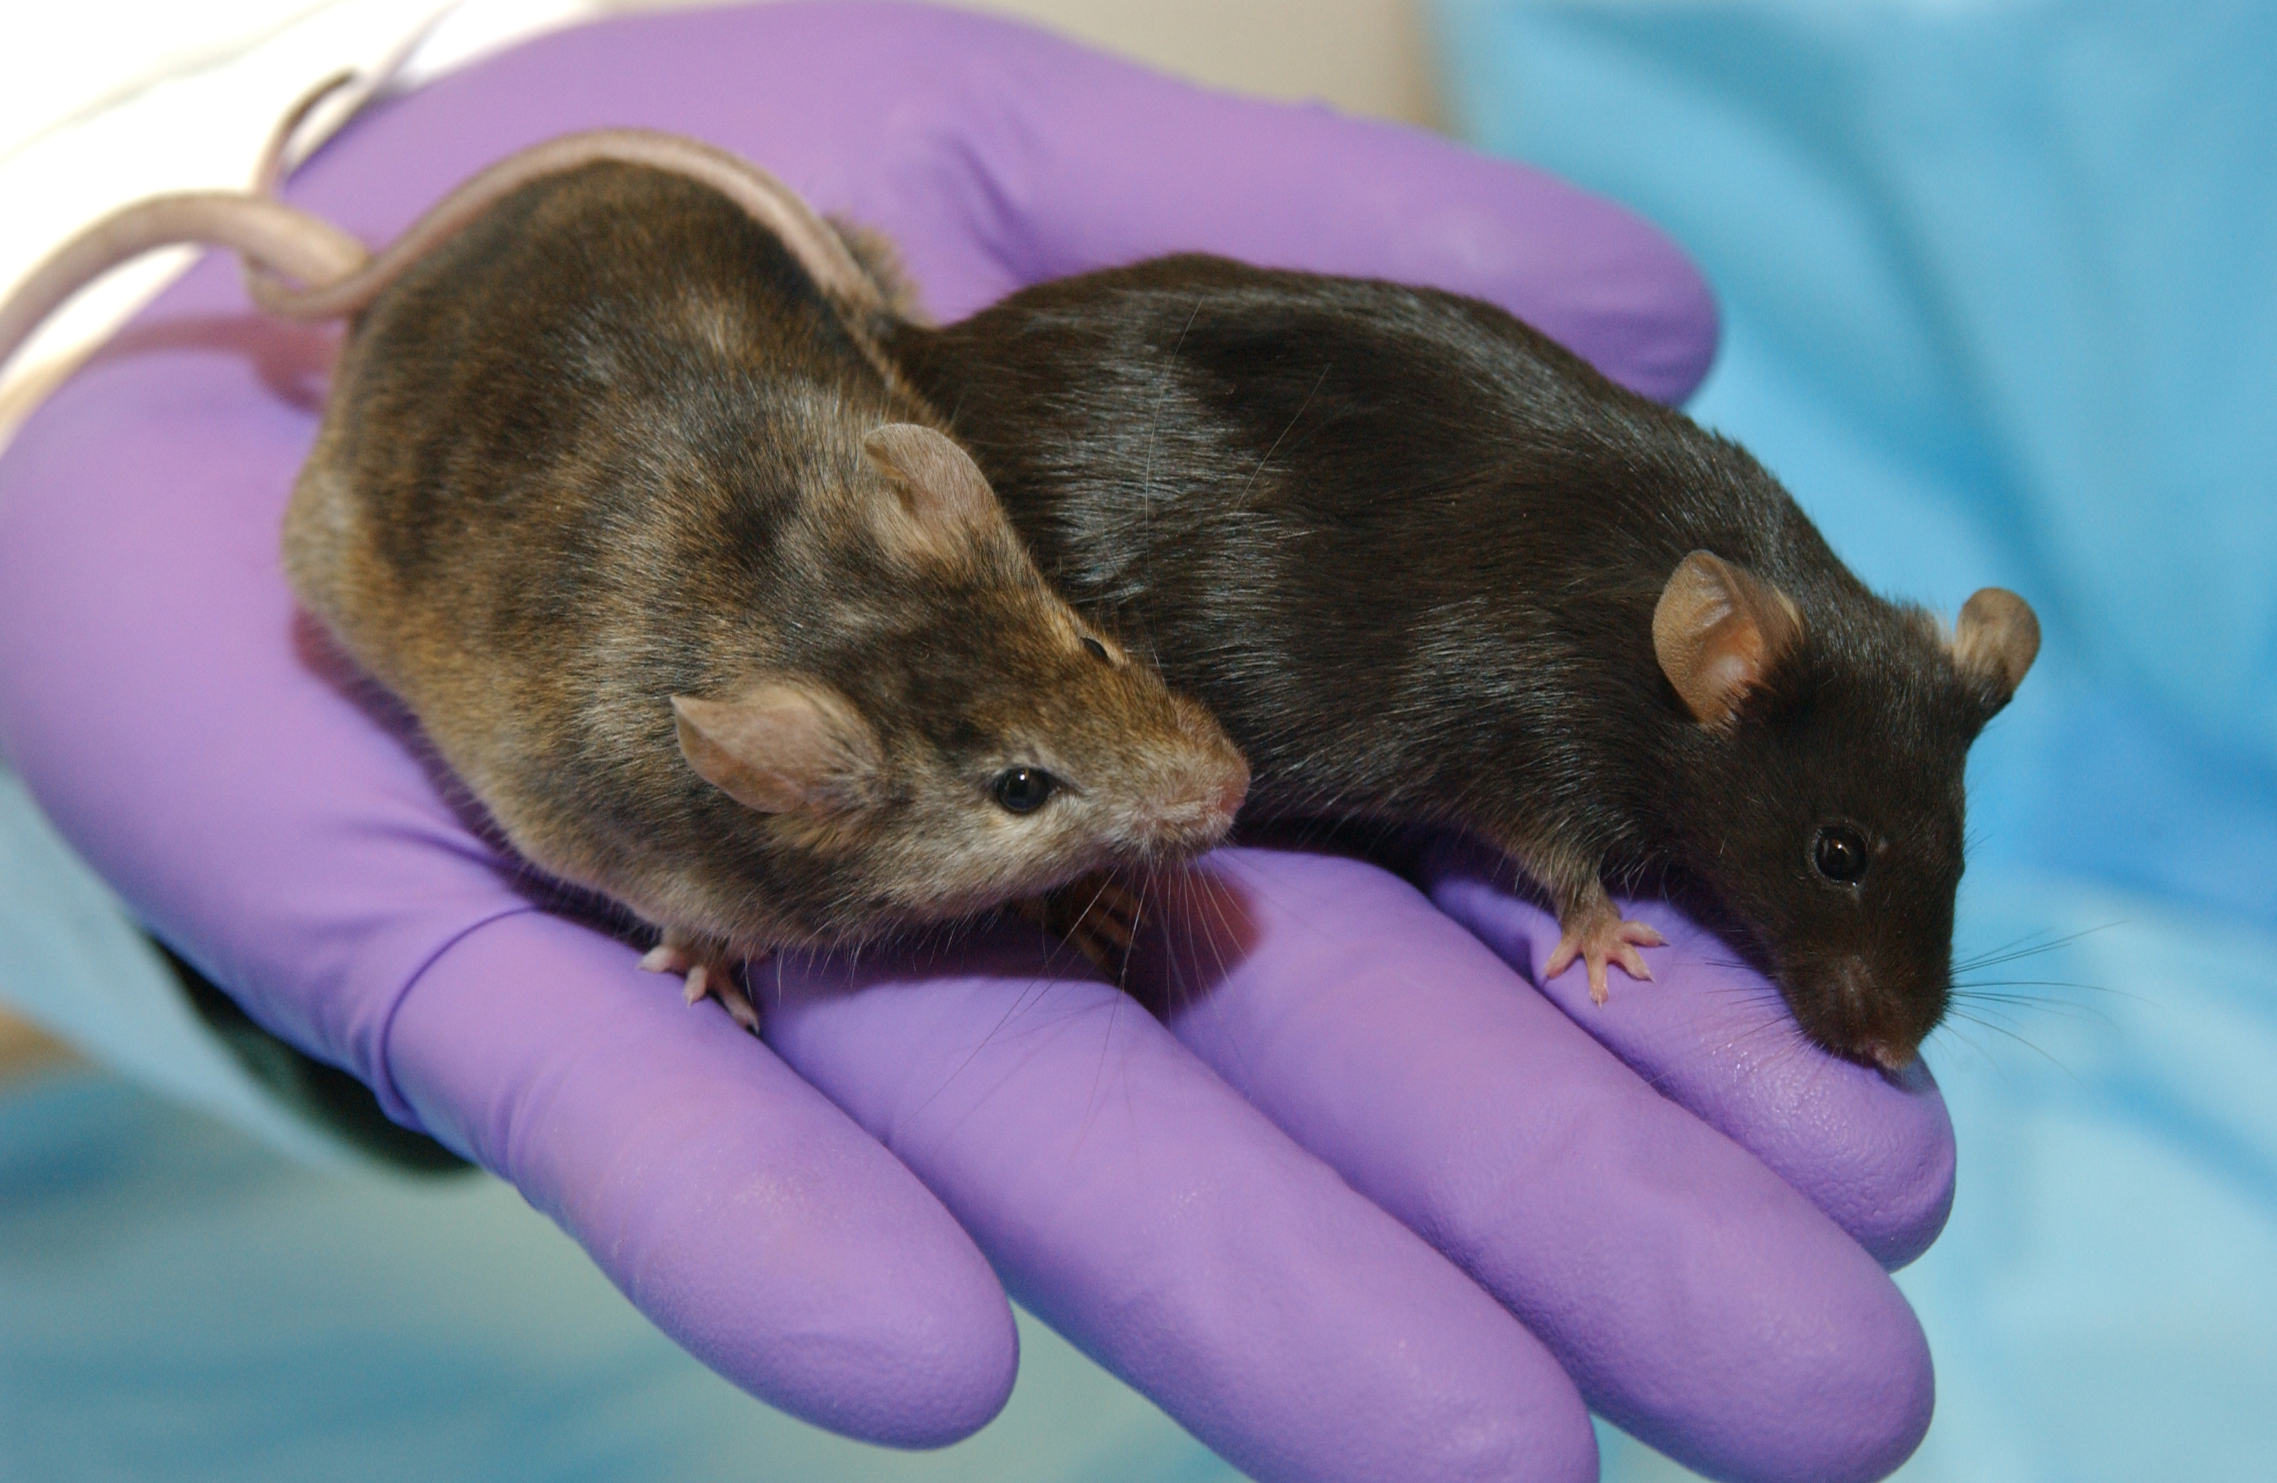
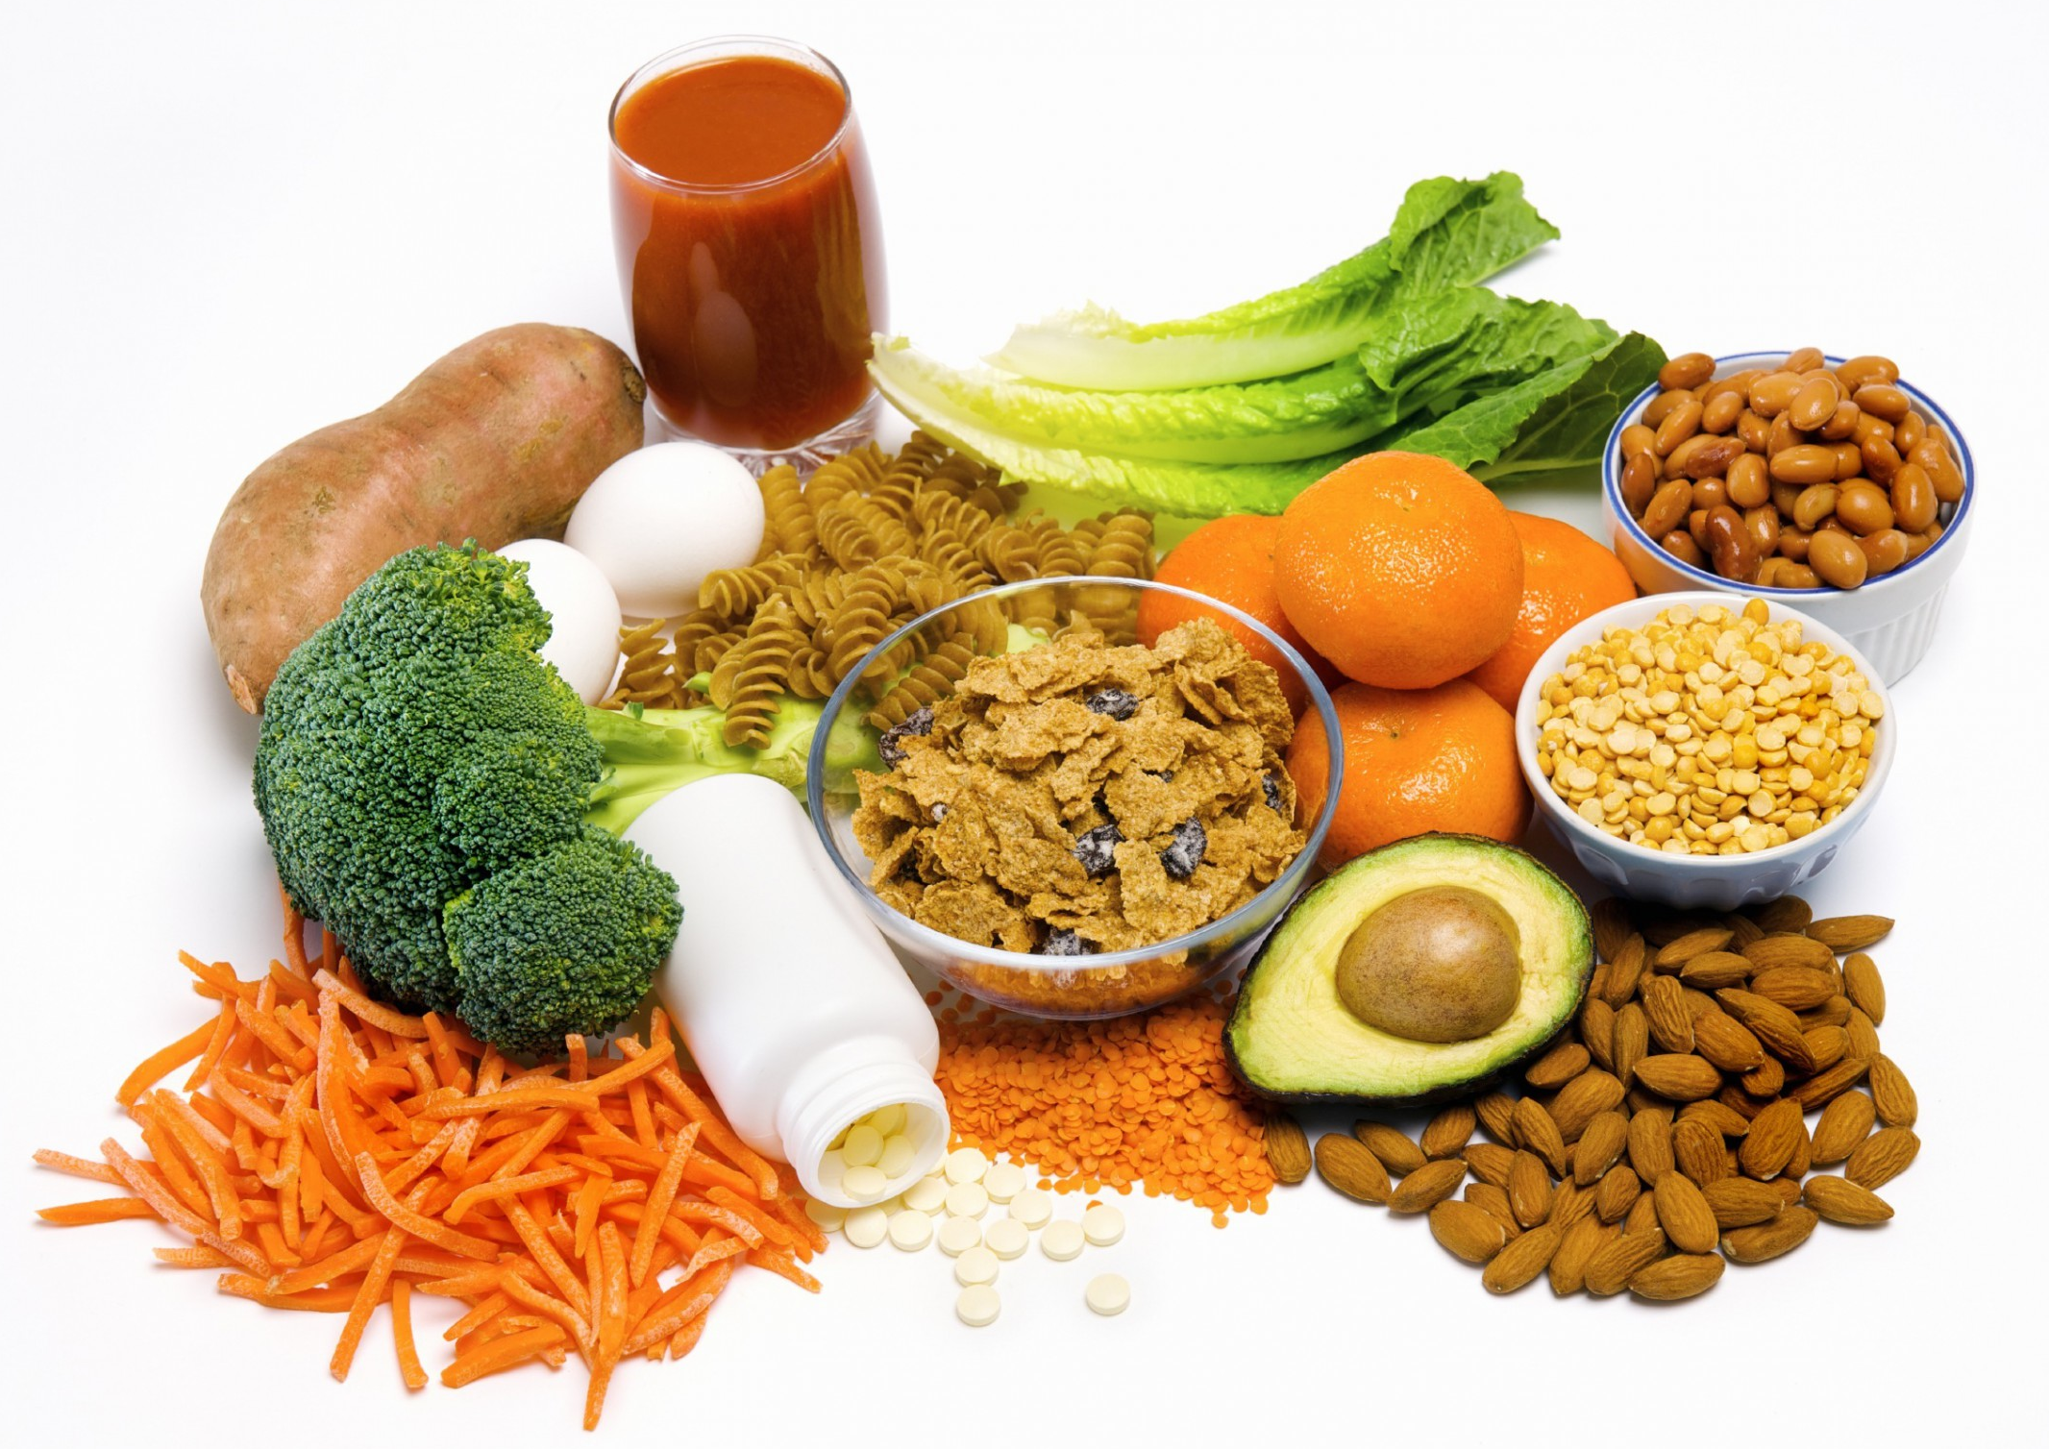
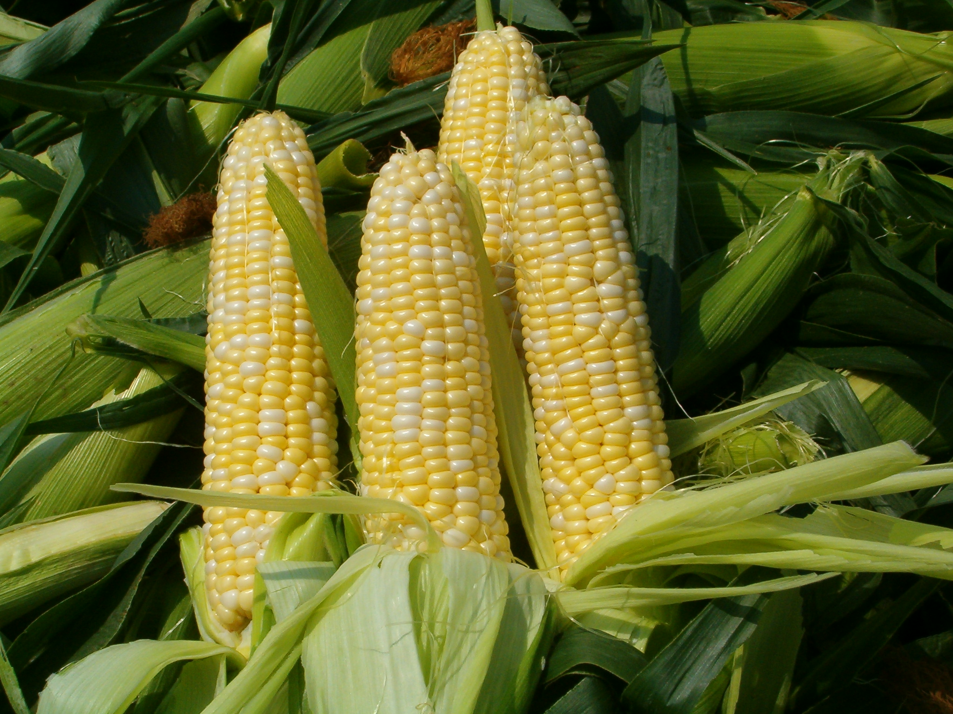
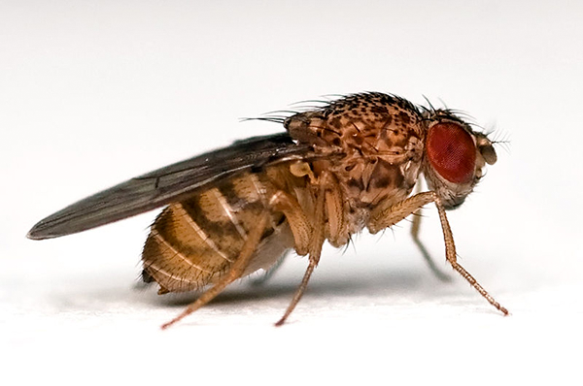

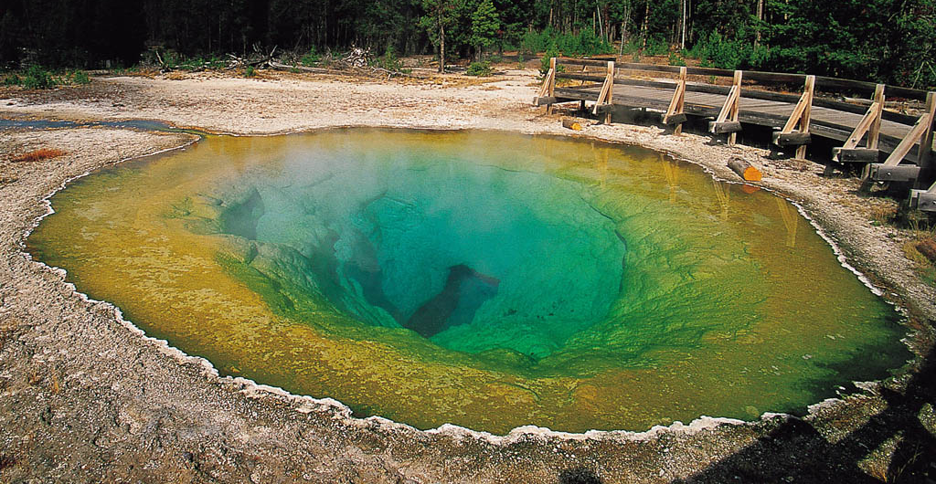
Human Health and Disease
Primate Models
Development Studies
Mouse Models
Nutrition Studies
Generalists
Agriculture Studies
Insect Models
The Built Environment
Environmental Communities
Notes:
Differential abundance testing from RNAseq methods
Issues can often be identified through unexpected features that show up across datasets

Slide 29
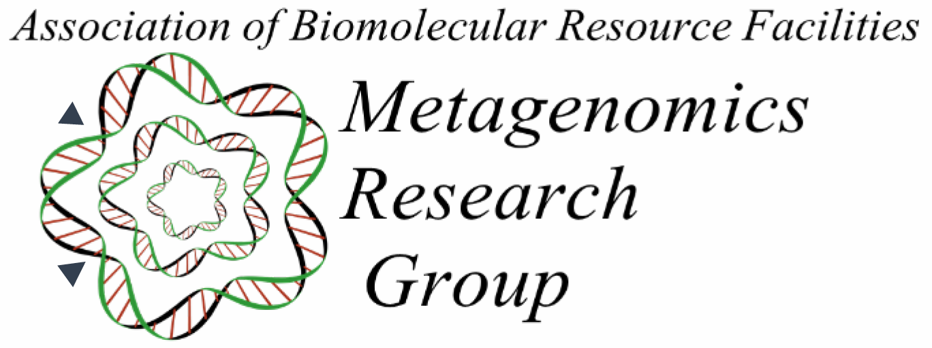
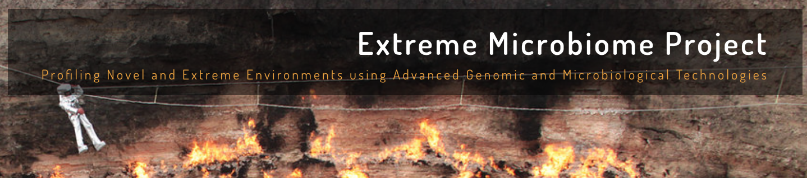
Network MGRG - eXtreme Microbiome Project
Notes:
Comprised of microbiologist, geneticists, bioinformaticians, ecologist, PI, core facilities and industry partners.
* The ABRF MGRG is working to develop a microbial reference standard to be used as a control similar to the ERCC controls. This standard will be composed of 6-10 microbes which are “fixed” and with a known cell number and can be added to samples as a matrix spike for recovery assays. The MGRG has established relationships with NIST and the ATCC
* ABRF / WACD
* Role of Cores are to facilitate research, so not saying you have to use a core to talk to a core, but rather we are a resource

Slide 30
Bioinformatics
Know and Understand the experiment
“The Question of Interest”
Build a set of assumptions/expectations
Mix of technical and biological
Spend your time testing your assumptions/expectations
Don’t spend your time finding the “best” software
Don’t under-estimate the time Bioinformatics may take
Be prepared to accept ‘failed’ experiments

Slide 31
Bottom Line
Spend the time (and money) planning and producing good quality, accurate and sufficient data for your experiment.
Get to know to your data, develop and test expectations
Result, you’ll spend much less time (and less money) extracting biological significance and results during analysis.

Slide 32
What do you get when you collaborate with the Bioinformatics Core
‘Borrow’ our computational resources
High throughput data requires a lot of storage and computing power
Immediate access to our experience and expertise
Ensures you’ll get high quality results and in a format you can actually use
We know how to select the optimal analysis
This results in a much quicker path to interpretation
Collaborating with the Bioinformatics core makes the project far more likely to succeed.
The sequencing experts contribute their expertise, the biologist contributes theirs, and the bioinformaticians contribute theirs

Slide 33
What is TagSeq
Generic name for 3’ biased transcriptome sequencing
Standard RNAseq has a bias associated with transcript length
In TagSeq methods one transcript -> one read
Interested in Differential Gene Expression AND NOT splice variation, transcript sequence, etc.
$104/sample
$184/sample w/data analysis

Slide 35
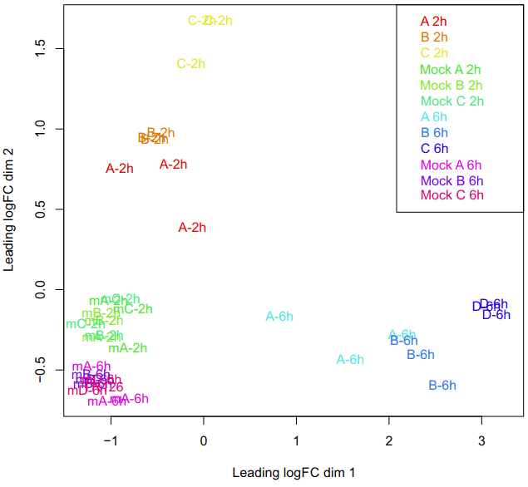

Slide 36
10x Genomics Single-cell RNAseq
Single-cell ATAC-seq, single-cell CGH,
single-cell immune profiling
Genome/exome sequencing

Slide 37
UCSF Illumina Novaseq
S4 – flowcells are the most cost effective
2x150bp reads, 12B reads per fun
Equivalent to ~32 lanes of HiseqX/4000
32 lanes of X is ~$41K
32 lanes of 4000 is ~$78K
1 flowcell S4 ~$31k/run
Can lane split to 4-lanes ~$9k/lane
Coordination between UCSF, UCB, UCSD, UCD

Slide 38
The mission of the Bioinformatics Core facility is to facilitate outstanding omics- scale research through these activities:
Data Analysis
The Bioinformatics Core promotes experimental design, advanced computation and informatics analysis of ‘omics’ scale datasets that drives research forward.
Research Computing
Maintain and make available high-performance computing hardware and software necessary for todays data-intensive bioinformatic analyses.
Training
The Core helps to educate the next generation of bioinformaticians through highly acclaimed training workshops, seminars and through direct participation in research activities.
Data Analysis
Research Computing
Training
Data Analysis
Research Computing
Training
Data Analysis
Research Computing
Training
Data Analysis
Research Computing
Training
Intelligently analyzing data from genomics, and other projects, to help drive research forward
Helping build high-performance software and hardware bioinformatics solutions
Providing acclaimed training workshops that will equip people with in-demand bioinformatics skills
Intelligently analyzing data from genomics, and other projects, to help drive research forward
Helping build high-performance software and hardware bioinformatics solutions
Providing acclaimed training workshops that will equip people with in-demand bioinformatics skills
Intelligently analyzing data from genomics, and other projects, to help drive research forward
Helping build high-performance software and hardware bioinformatics solutions
Providing acclaimed training workshops that will equip people with in-demand bioinformatics skills
Intelligently analyzing data from genomics, and other projects, to help drive research forward
Helping build high-performance software and hardware bioinformatics solutions
Providing acclaimed training workshops that will equip people with in-demand bioinformatics skills

Slide 39
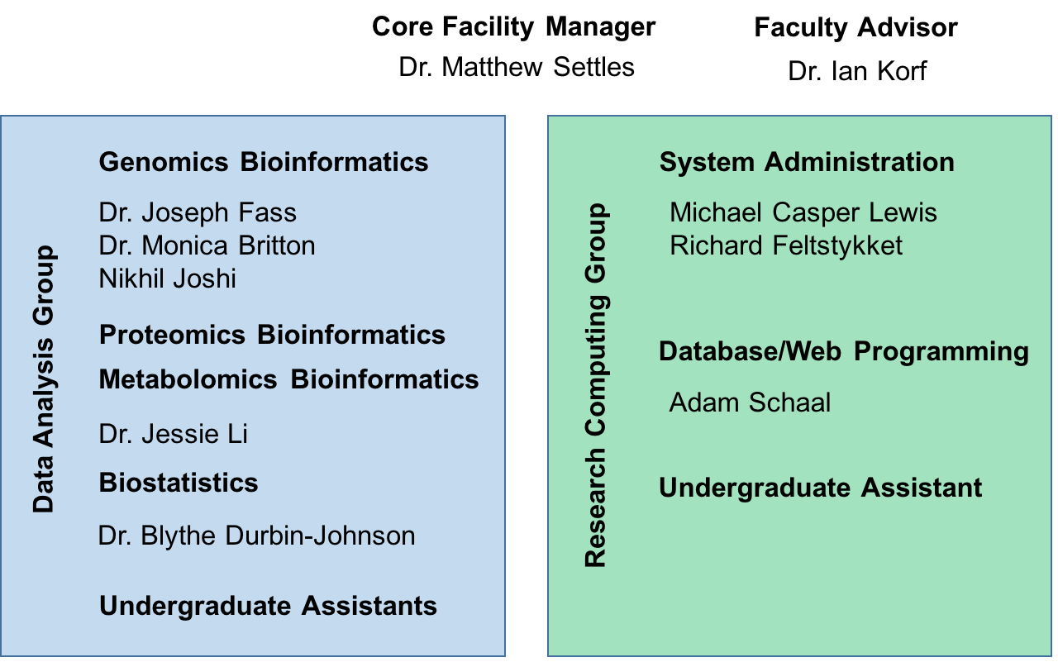
UC Davis Bioinformatics Core in the Genome Center

Slide 40
Contacts
Bioinformatics related questions, include but not limited to
bioinformatic methods questions, software use, data questions
Bioinformatics.core@ucdavis.edu
Computing Issues, include but not limited to
User account questions, equipment failure/malfunction, software install, software failures (not related to use)
helpdesk@genomecenter.ucdavis.edu
Training courses information
training.bioinformatics@ucdavis.edu

